Slide 1
Day 14
Fundamental Problems in Mobile Robotics

Slide 2
Sensing the Environment
Bug1 and Bug2 use a perfect contact sensor
we might be able to achieve better performance if we equip the robot with a more powerful sensor
a range sensor measures the distance to an obstacle; e.g., laser range finder
emits a laser beam into the environment and senses reflections from obstacles
essentially unidirectional, but the beam can be rotated to obtain 360 degree coverage

Slide 3
Tangent Bug
assumes a perfect 360 degree range finder with a finite range
measures the distance ρ(x, θ) to the first obstacle intersected by the ray from x with angle θ
has a maximum range beyond which all distance measurements are considered to be ρ = ∞
the robot looks for discontinuities in ρ(x, θ)

Slide 4
Tangent Bug
O₂
O₃
O₁
O₆
O₄
O₅

Slide 5
Tangent Bug
currently, bug thinks goal is reachable
goal

Slide 6
Tangent Bug
once the obstacle is sensed, the bug needs to decide how to navigate around the obstacle
move towards the sensed point O_{i} that minimizes the distance d(x, O_{i}) + d(O_{i}, q_{goal}) (called the heuristic distance)
O₁
goal

Slide 7
Tangent Bug
if the heuristic distance starts to increase, the bug switches to boundary following
full details
Principles of Robot Motion: Theory, Algorithms, and Implementations
http://www.library.yorku.ca/find/Record/2154237
nice animation
http://www.cs.cmu.edu/~motionplanning/student_gallery/2006/st/hw2pub.htm
goal

Slide 8
Localization for a Point Robot
Bug1 and Bug2 assume that the robot can perfectly sense its position at all times
consider a 1D point robot (moves on the x-axis) that moves a distance Δx_{i}
after taking N steps starting from x₀ it can be shown that (textbook Chapter 2):

Slide 9
Characterizing Error
1D normal, or Gaussian, distribution
standard deviation
variance

Slide 10
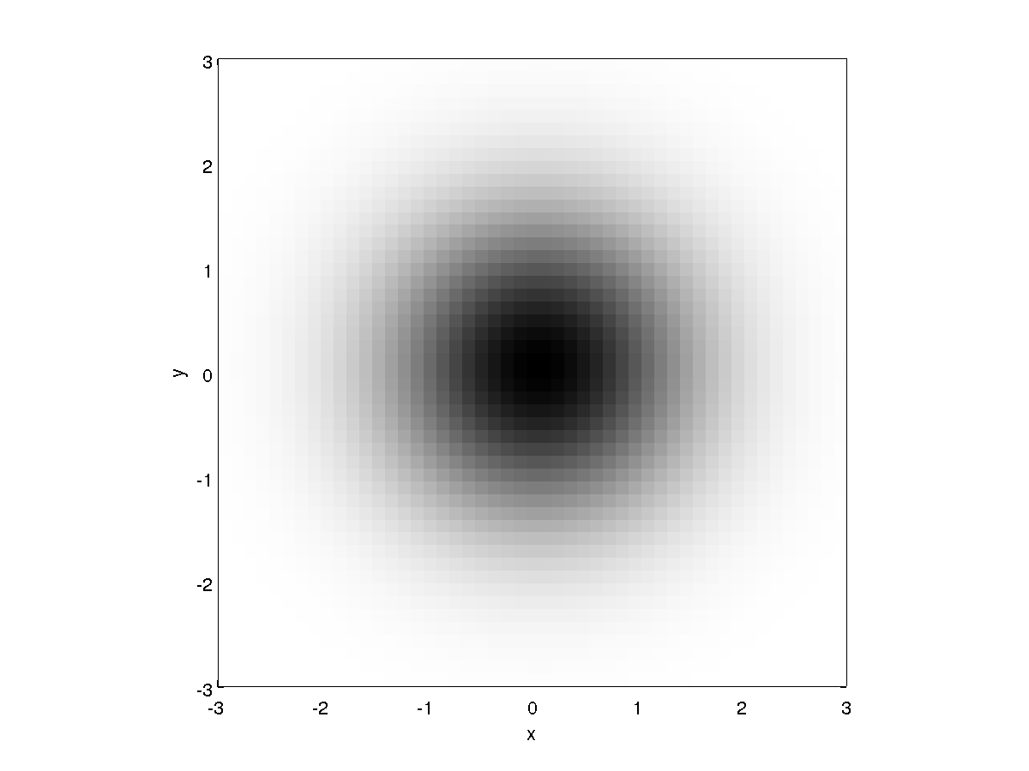
Characterizing Error
in 2D
isotropic

Slide 11
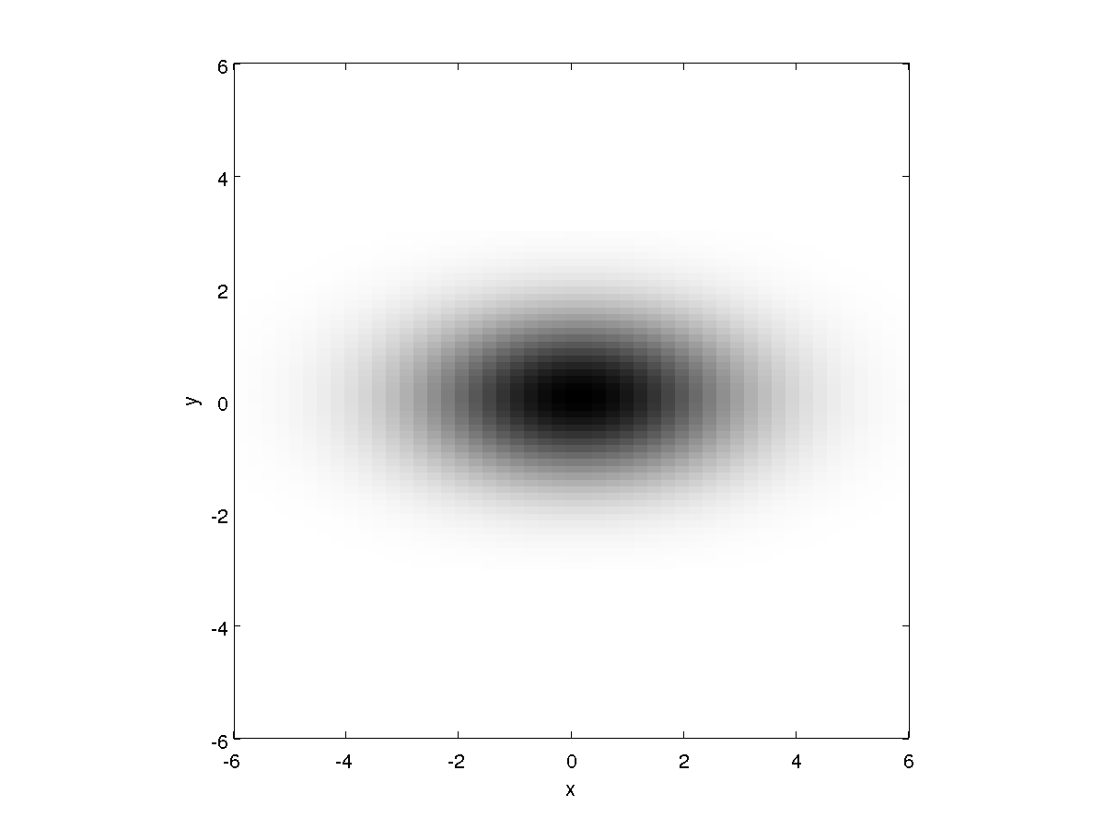
Characterizing Error
in 2D
anisotropic

Slide 12
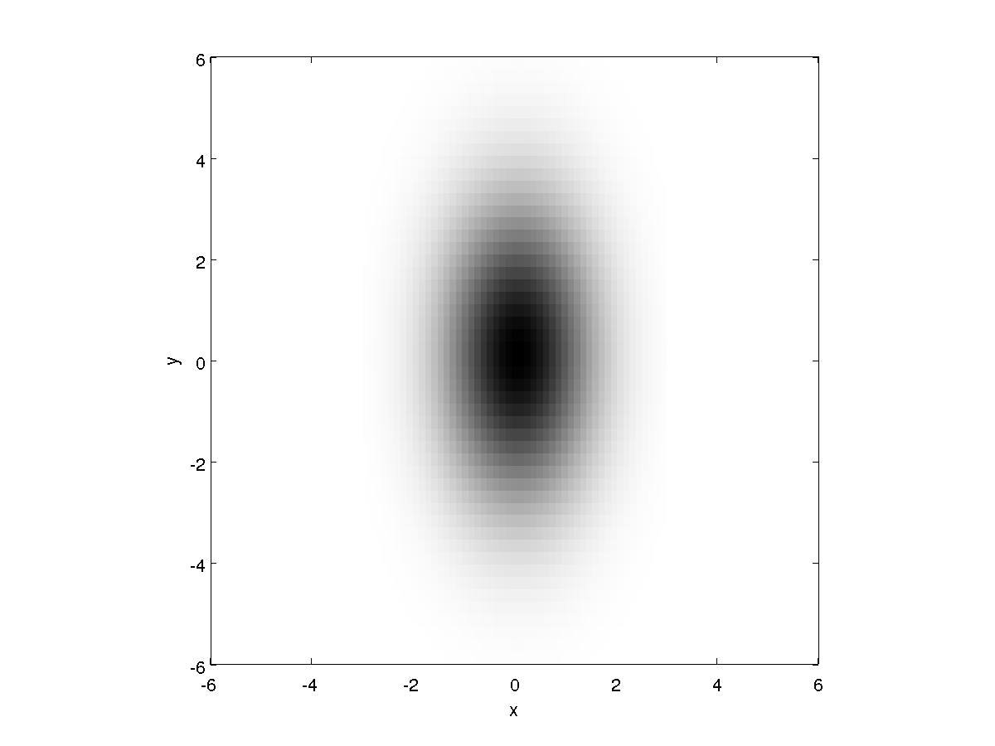
Characterizing Error
in 2D
anisotropic

Slide 13
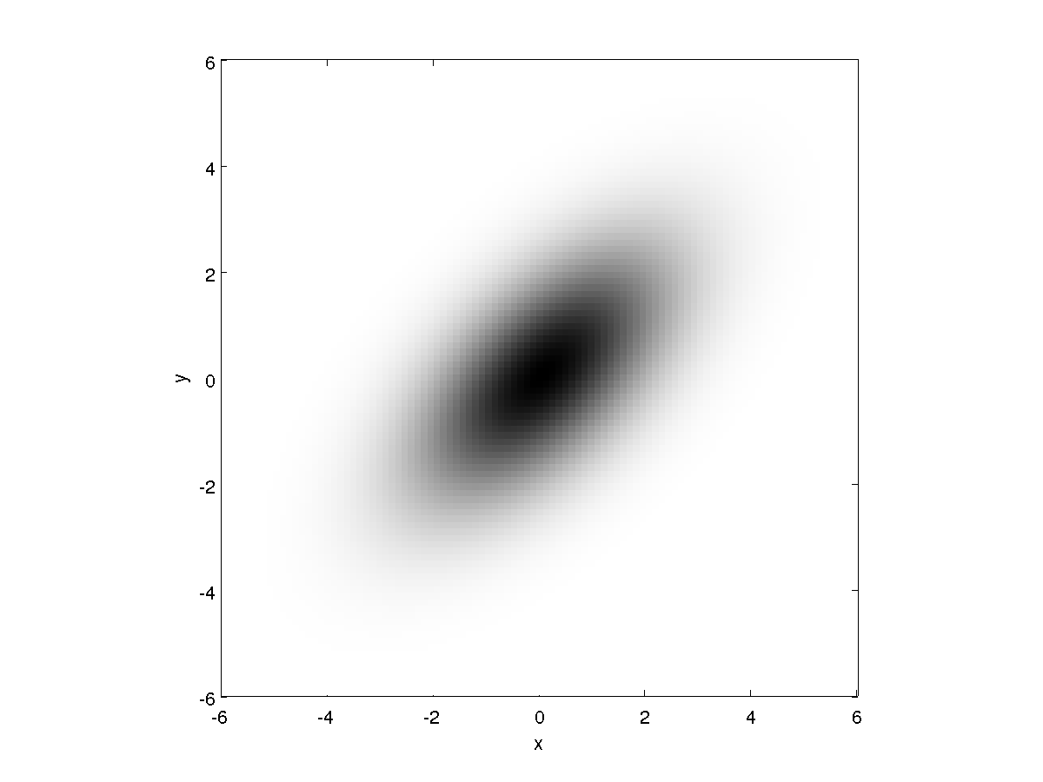
Characterizing Error
in 2D
anisotropic

